Slide 1
Active Directory Domain Services
System Administration and Management
CODE: ET 8413
FACILITATOR: FRANK
EMAIL: frankibrahim25@gmail.com

Slide 2
Domain controller(DC)
A Domain is a logical grouping of users, systems, applications, and resources that are managed under a single administrative structure.
This structure allows for centralized management of security policies and user access rights.
Domains are primarily used in Microsoft Windows Active Directory environments to centralize and streamline the management of resources, security, and authentication.

Slide 3
A domain controller is a server running the Active Directory Domain Services (AD DS) role.
A Domain Controller (DC) allows the creation of logical containers.
These containers consist of users, computers and groups.
When you install Windows Server on a computer, you can choose to configure a specific server role for that computer.

Slide 4
Active Directory Domain Services (AD DS)
A directory is a hierarchical structure that stores information about objects on the network.
A directory service, provides the methods for storing directory data and making this data available to network users and administrators.
Active Directory (AD) is a directory service developed by Microsoft, primarily used for managing permissions and access to network resources within Windows domain networks.

Slide 5
Active directory provide an authentication and authorization systems to network resources.
The information stored in Active Directory is referred to Active Directory objects and makes this information easy for administrators and users to find and use.
Active Directory Objects: These are entities within AD that represent users, groups, computers, printers, and other resources. Each object has attributes that define its characteristics and permissions.

Slide 6
Inside the domain objects are classified into organizational units(Ous).
Organizational Units (OUs): OUs are container objects within Active Directory that allow administrators to group related objects together.
They provide a way to organize users, computers, and other resources based on common characteristics such as department, location, or function.

Slide 7
Active Directory Forest
An Active Directory forest is the highest level of organization within the Active Directory (AD) structure, serving as a container for one or more domains that share a common schema and configuration.
It represents a security boundary and provides a framework for managing network resources across multiple domains.

Slide 8
A forest can contain multiple domains, each of which can have its own organizational units (OUs), user accounts, and resources.
All domains within a forest share a common schema, which defines the types of objects that can exist in the directory and their attributes.
This ensures consistency in how data is structured and accessed across the domains.
The forest acts as a security boundary, meaning that objects in different forests cannot interact unless trust relationships are established.

Slide 9
Creating a new Active Directory Forest
Install Active Directory Domain Services (AD DS)
Open Server Manager.
Click on Add Roles and Features.
Follow the wizard to install the Active Directory Domain Services role.
Promote Server to a Domain Controller:
Return to Server Manager and click on the notification.
Select Promote this server to a domain controller.
Choose Add a new forest and enter your desired root domain name (e.g., yourdomain.com).

Slide 10
Creating a new Active Directory Forest
Configure Forest and Domain Settings:
Set the forest and domain functional levels (choose the highest level supported by your environment).
Specify the Directory Services Restore Mode (DSRM) password.
Configure additional options as necessary, such as DNS settings.
Review your configurations and click Install. The server will reboot upon completion, becoming the first domain controller and root of your new AD forest.

Slide 11
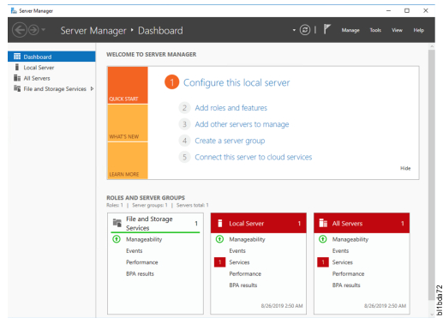
Install and configure Active Directory
Navigate to the Windows Server Manager.
Click Add Roles and Features.

Slide 12
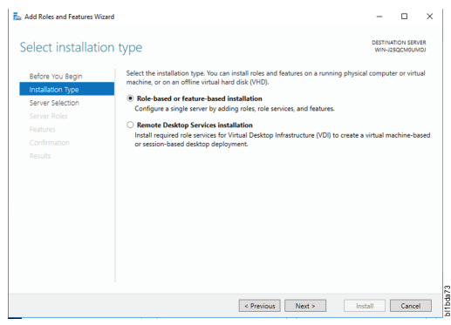
It will open Add Roles and Features wizard. Click Next

Slide 13
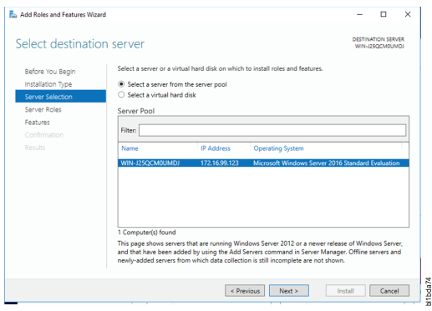
Select the server from the server pool and click Next

Slide 14
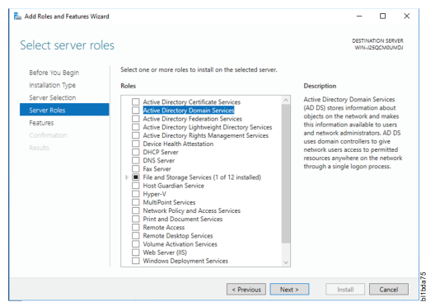
Click Checkbox to select Active Directory Domain Services

Slide 15
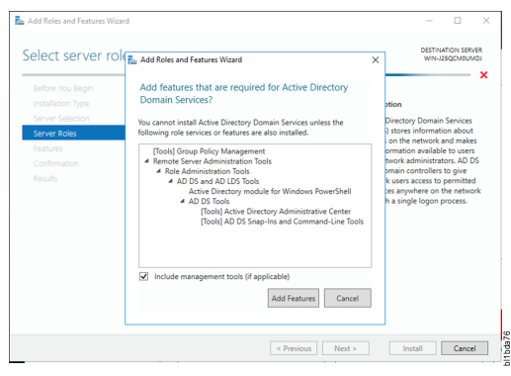
On the popup Window, just click Add Features.

Slide 16
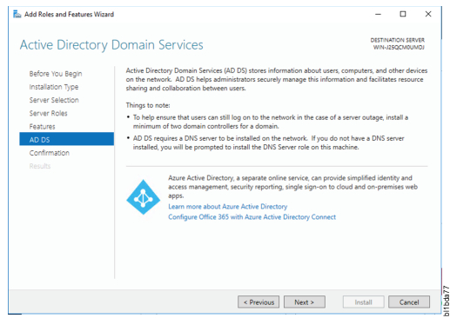
On the description window of Active Directory Domain Services, click Next.

Slide 17
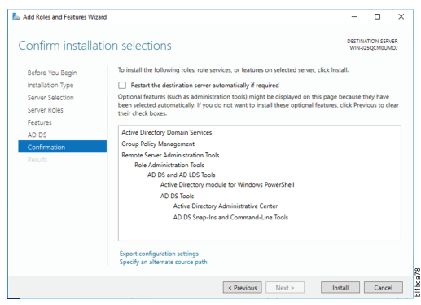
Click Install on the Confirmation window

Slide 18
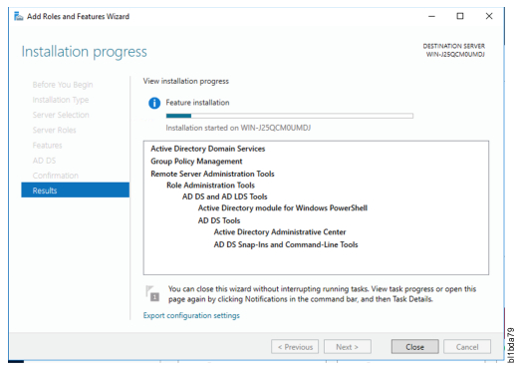
Installation process begins.

Slide 19
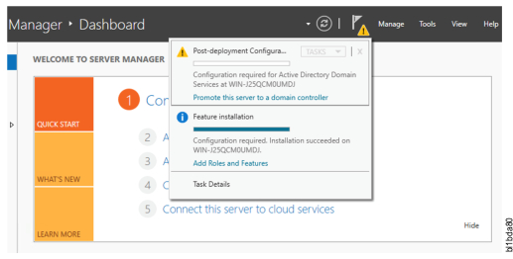
After installing AD DS Role, you can promote this Server to a Domain Controller

Slide 20
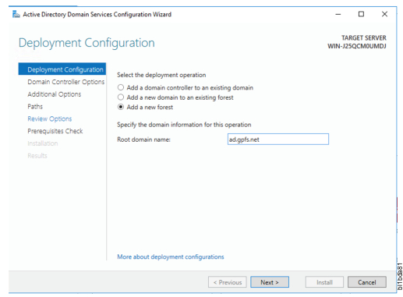
Select Add a new forest and give the Root domain name, ad.gpfs.net. Click Nex

Slide 21
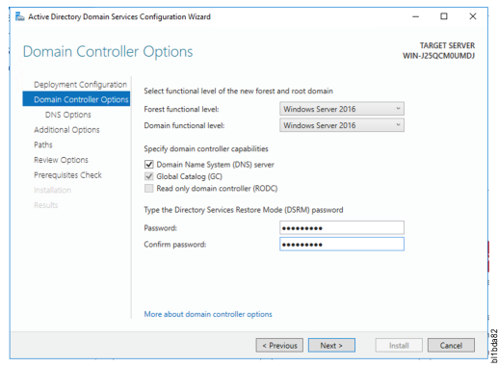
Enter the Directory Services Restore Mode password

Slide 22
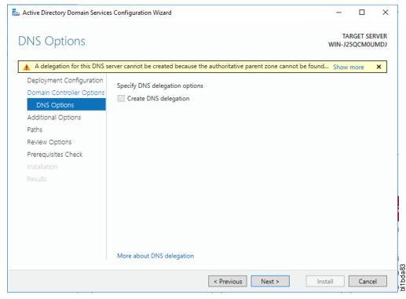
Ignore the warning message

Slide 23
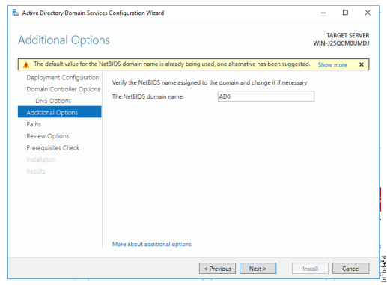
Use the default NetBIOS domain name and click Next

Slide 24
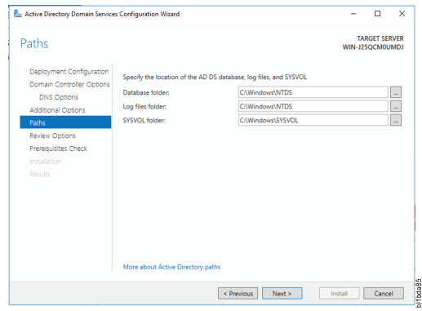
Use the default paths and click Next.

Slide 25
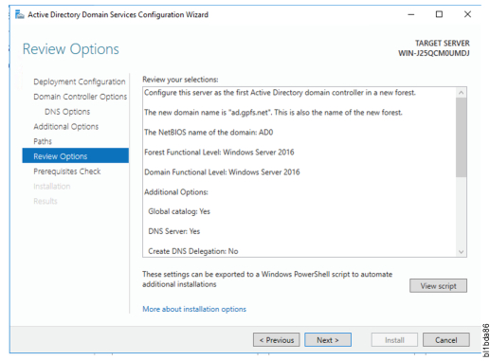
Review and click Next if no errors

Slide 26
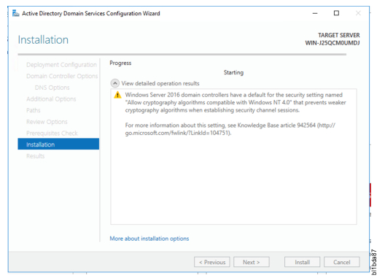
Click Install and wait for the installation to finish.

Slide 27
The Domain Controller is now set up.

Slide 28
Features of server operating systems
Multi-User Support: Server OS can handle multiple users at once, managing resources efficiently to ensure smooth operation during peak usage times.
Security and Access Control: Robust security features allow administrators to set permissions and control access to sensitive data, protecting against unauthorized access.
Resource Management: These operating systems optimize hardware resources (CPU, memory, storage) for maximum efficiency and performance.

Slide 29
Scalability and Reliability: Server OS are designed to scale easily with increased workloads and provide features like failover and backup to ensure continuous operation.
Networking Capabilities: They support various networking protocols, enabling communication between servers and clients for functions such as file sharing and email hosting.

Slide 30
Types of server operating systems
Windows server: Windows server is known for its user-friendly interface and integration with other Microsoft products.
It supports enterprise-level management and supports Active Directory, group policies, and centralized domain management.
Versions of Windows Server include Windows Server 2016, 2019, 2022, and others, each offering enhanced features over its predecessor.

Slide 31
Linux Server: An open-source operating system that is highly regarded for its stability and security.
Linux is widely used in web servers and enterprise applications due to its flexibility and cost-effectiveness.
There are many Linux distributions tailored for servers, including Ubuntu Server, CentOS/RHEL (Red Hat Enterprise Linux), Debian, Fedora Server, and SUSE Linux Enterprise Server.
Linux is highly customizable, often controlled via command-line interface (CLI), although graphical user interfaces (GUIs) are available for some distributions.

Slide 32
That’s all for today

